Slide 1
ENG4118/5326 - Robotics 4/M Sensors, Actuators and Image capture, processing and analysis
Lecture 7
Kevin Worrall

Slide 2
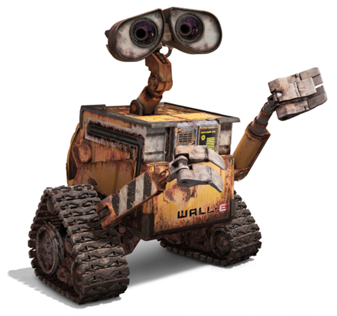
Lecture Overview
Proximity Sensors
Mechanical Switches
Capacitive
Eddy Current
Inductive
Pneumatic
Light Sensors
Photosensitive Devices

Slide 3
Proximity Sensors

Slide 4
Proximity Sensors
Proximity
normally used as external sensors for overall task control purposes
Used to detect how close another object is before contact is made
This sensing can be useful in many situations e.g.
measuring rotor speed
Navigating a robot
There are many different types of proximity sensor
magnetic, eddy current, Hall effect, optical, ultrasonic, capacitive and inductive...

Slide 5
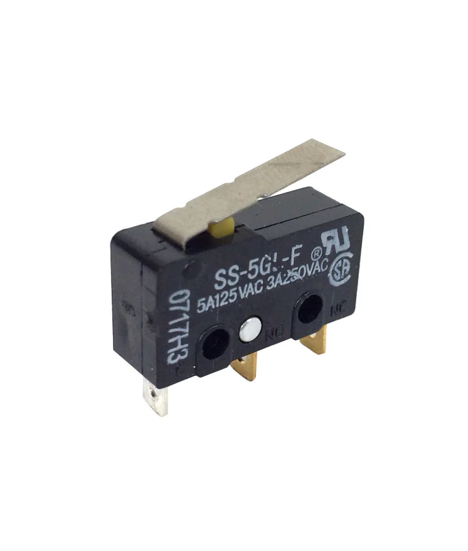
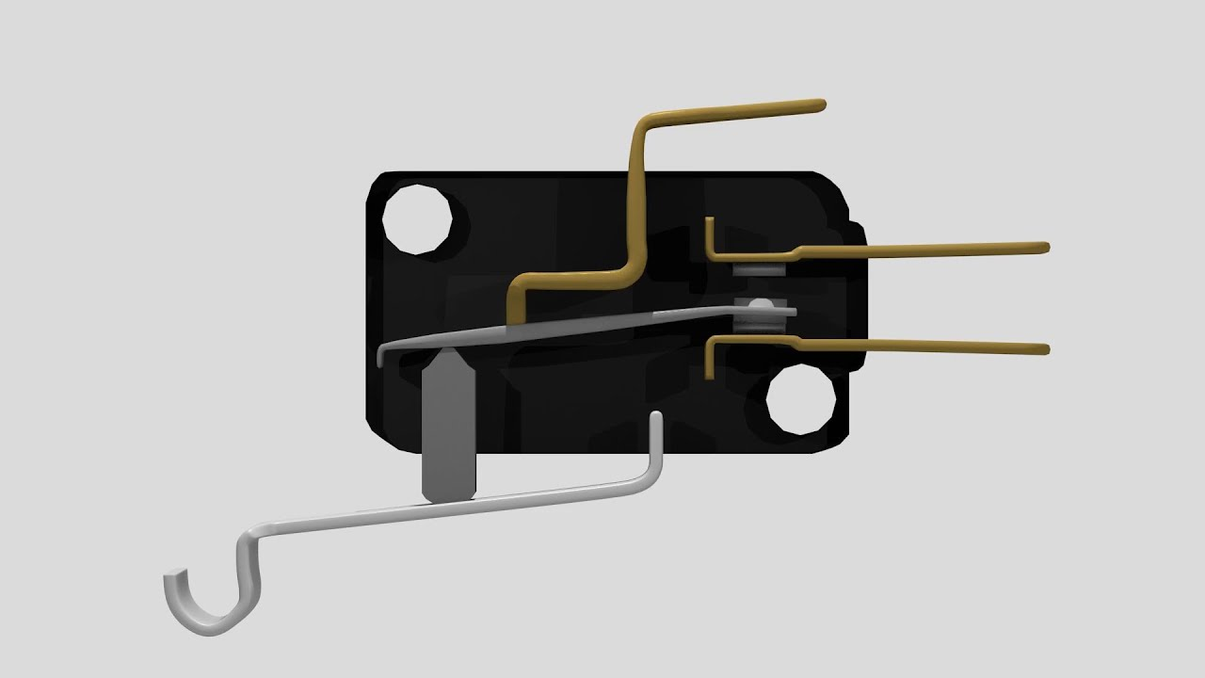
Proximity Sensors – Mechanical Switches
Can be activated by the presence of an object to give an output which is either on or off
Microswitch are the primary example. Small electrical switch which requires physical contact and a small operating force to close the contacts
These types of switches are generally robust, simple and inexpensive
A lever operated switch is shown which uses physical contact to close the contacts

Slide 6
Proximity Sensors - Capacitive
used over small distances to measure the distance between two conducting surfaces
For two parallel conducting plates the capacitance is given by:
where A is capacitor plate area, d is plate separation, ε_{o} is the permittivity of free space and ε_{r} is the permittivity of the dielectric material between the plates
$$c=\frac{ε_{o }ε_{r}A}{d}$$

Slide 7
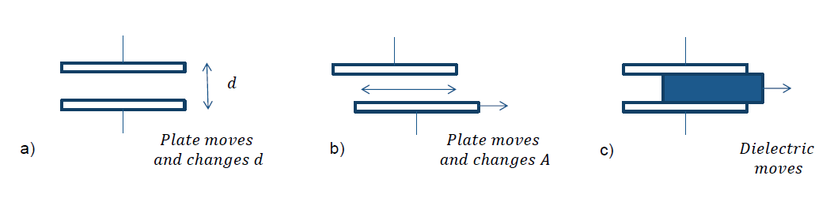
Proximity Sensors - Capacitive
Capacitive displacement sensing can be achieved by:
Variation of the spacing of the plate separation distance, d (shown in a)
Variation of the plate overlap area, A (shown in b)
Change in relative permittivity ε_{r} due to movement of dielectric material between the plates. (shown in c)

Slide 8
Proximity Sensors - Capacitive
Capacitive
For a displacement - if the separation d is increased by displacement x then the capacitance becomes:
The change in capacitance Δc as a fraction of the initial capacitance is given by:
There is a non-linear relationship between the change in capacitance ΔC and the displacement x
This non-linearity can be overcome by using a push-pull displacement sensor
$$c−Δc=\frac{ε_{o }ε_{r}A}{d+x}$$
$$\frac{Δc}{c}=\frac{d}{d+x}−1=\frac{(\frac{x}{d})}{1+(\frac{x}{d})}$$

Slide 9
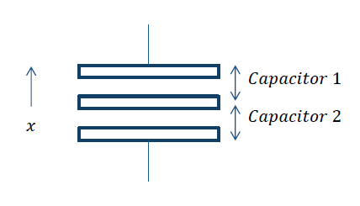
Proximity Sensors - Capacitive
The push-pull displacement sensor consists of three plates with the upper two plates forming one capacitor and the lower pair forming a second capacitor
Displacement moves the central plate between the other two plates
For example, the result of the central plate moving downwards is to increase the plate separation of the upper capacitor and decrease that of the lower one

Slide 10


Proximity Sensors - Capacitive
The change in capacitance for the upper and lower capacitors can be defined as opposite
When c₁ is in one arm of an A.C. bridge and c₂ is in the other, the resulting out of balance voltage is proportional to x
These sensors are used to monitor displacements from a few mm to the decimetre range
$$c_{1}=\frac{ε_{o }ε_{r}A}{d+x}$$
$$c_{2}=\frac{ε_{o }ε_{r}A}{d−x}$$

Slide 11
Proximity Sensors - Capacitive
Non-linearity and hysteresis errors are about 0.01% of full range for this sensor.
One form of the capacitive proximity sensor consists of a single capacitor plate probe with the other plate being formed by the object to be sensed.
The object here must be metallic and earthed for this method to work.
As the object approaches the plate, separation of the capacitor changes and becomes significant and detectable when the object is close to the probe.

Slide 12
Proximity Sensors - Capacitive
Non-linearity and hysteresis errors are about 0.01% of full range for this sensor.
One form of the capacitive proximity sensor consists of a single capacitor plate probe with the other plate being formed by the object to be sensed.
The object here must be metallic and earthed for this method to work.
As the object approaches the plate, separation of the capacitor changes and becomes significant and detectable when the object is close to the probe.
Example of a Capacitive Sensor
https://www.youtube.com/watch?v=NC5bNjbdBMA

Slide 13
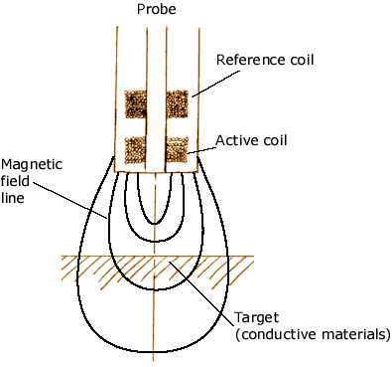
Proximity Sensors - Eddy Current
A coil carrying an alternating current produces an alternating magnetic field which induces eddy currents (electric currents) within any metallic object in that field
This itself gives rise to a magnetic field which distorts the field which produced it and results in a change in the impedance of the coil and thus the amplitude of the alternating current
At some pre-set level this change in current can then be used to trigger a switch.

Slide 14
Proximity Sensors - Eddy Current
This sensor is used to detect non-magnetic but conductive materials
Advantages of these sensors are they are small, relatively inexpensive, have high reliability and have high sensitivity to small displacements
However
there is a need for signal conditioning to be done
Often included with the sensor but can require mass and volume
Example of an Eddy Current Sensor
https://www.youtube.com/watch?v=MqFXFnkHk-8

Slide 15
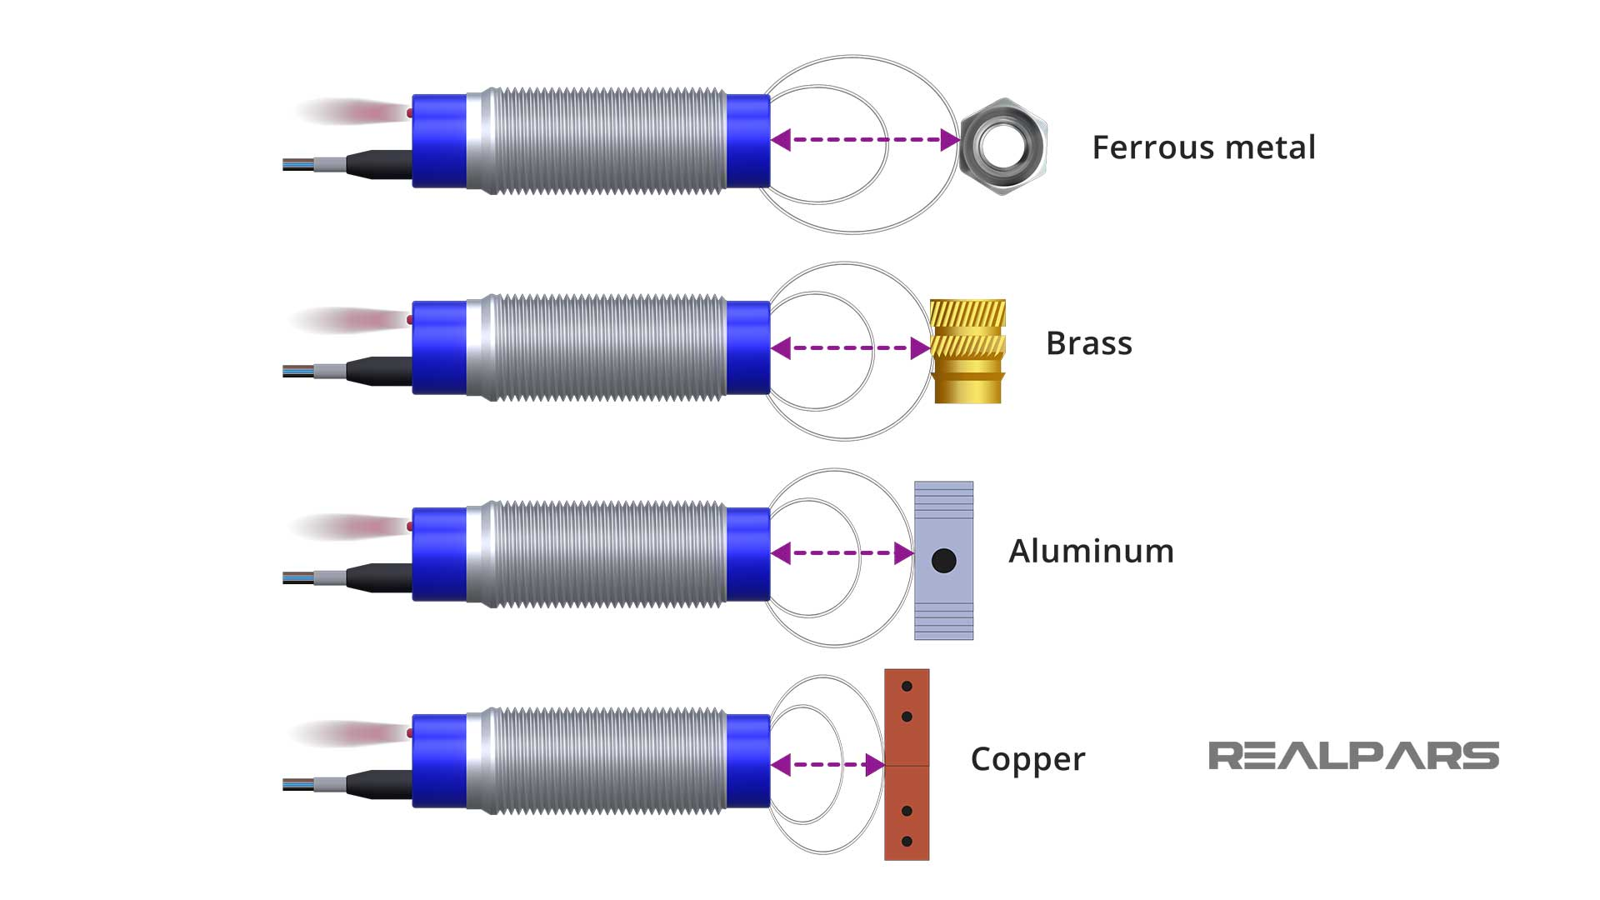
Proximity Sensors - Inductive
Uses a coil wound around the core of a magnetic material with the inductance of the coil changing when the end of the coil becomes close to any metal object (usually ferrous).
Change in inductance is detected by its effect on a resonant circuit which is used to trigger a switch
An example of this type of device is the
variable reluctance tachometer described previously

Slide 16
Proximity Sensors - Inductive

Slide 17
Proximity Sensors - Inductive
https://www.youtube.com/watch?v=Lz4BHL65CNA
https://www.ti.com/lit/ml/slyp719/slyp719.pdf?ts=1705951012959&ref_url=https%253A%252F%252Fwww.google.com%252F

Slide 18
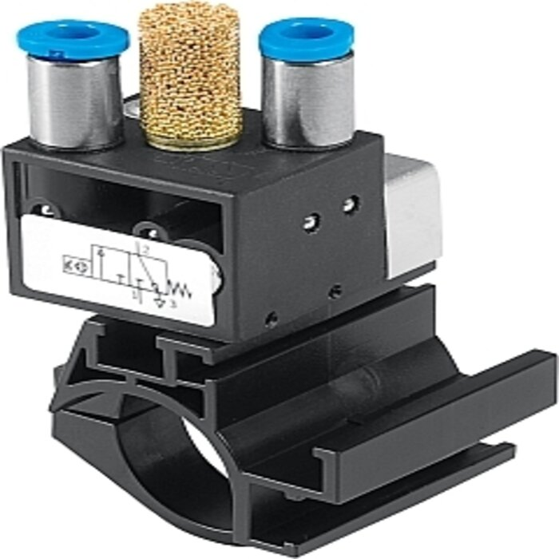
Proximity Sensors - Pneumatic
These depend upon the change in air pressure when a source of compressed air comes near an object
Low air pressure is supplied through inlets and escapes through a port in the front of the sensor
In the absence of any object, pressure is reduced in the sensor output port
When an object is present the air can’t readily escape and results in the pressure of the output port increasing
The pressure in the sensor output port is dependent upon the proximity of objects
These sensors are used for a displacement range between 3 and 12mm

Slide 19
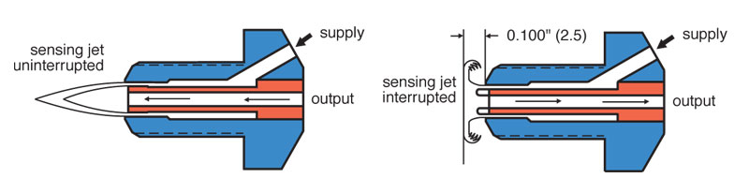
Proximity Sensors - Pneumatic

Slide 20
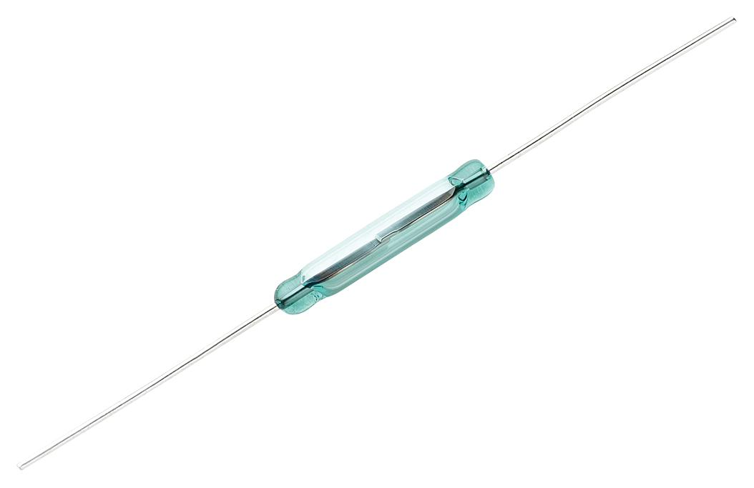
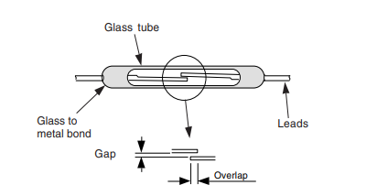
Proximity Sensors – Reed Switches
It consists of two magnetic switch contacts sealed in a glass tube.
When a magnet is brought close to the magnetic reeds they are attracted to each other and close the switch contacts
It is a non-contact switch and widely used for checking the closure of doors
It is also used with tachometers where if one of the teeth has a magnet attached to it then the switch will close every time the magnet passes it producing a current in the associated circuit.

Slide 21
Proximity Sensors – Light Sensors
Light Sensors Any sensors that responds to light
Photodiodes Semi-conductor junction diodes that can be used in a circuit with a reverse bias on the diode so that it presents a high resistance and no current flows. When light falls on the junction the resistance of the diode decreases and a current can flow within the circuit.

Slide 22
Proximity Sensors – Light Sensors
Phototransistors Are transistors that have a light sensitive p-n junction and have a very small collector-emitter current when no light falls on the junction. When light falls on the phototransistor a base current is produced which is proportional to light intensity leading to a proportional collector current.
Photoresistors are resistors that have a resistance which depends on the intensity of light falling on the device. Materials common for this are Cadmium Sulphide (for wavelengths < 515nm) or Cadmium Selenide (for wavelengths < 700nm) and the resistance falls linearly as the light intensity increases.

Slide 23
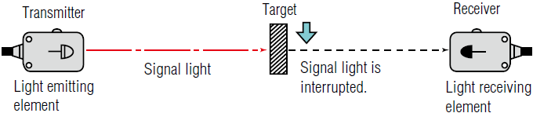
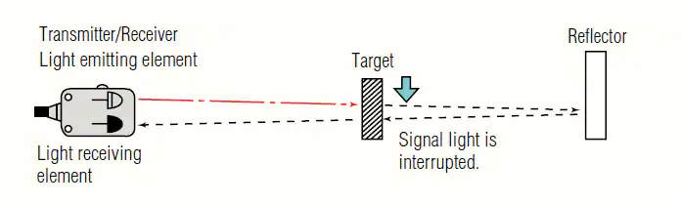
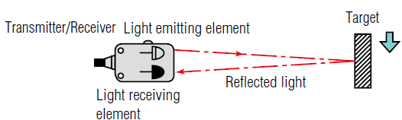
Proximity Sensors – Photosensitive Devices
Can be used to detect the presence of an opaque object by
breaking a beam of light, or infrared radiation, falling on such a device
by detecting light reflected by the object
Through Beam, Retro-reflective, Reflective

Slide 24
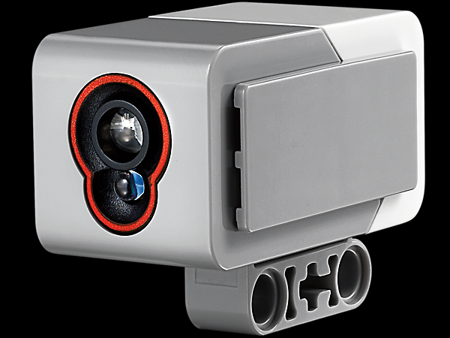
Proximity Sensors – Photosensitive Devices

Slide 25
Review
Proximity Sensors
Mechanical Switches
Capacitive
Eddy Current
Inductive
Pneumatic
Light Sensors
Photosensitive Devices

Slide 26
References
Bolton, W., Mechatronics, 5th Edition, Pearson, 2012
Niku, S.B. , Introduction to Robotics, 2nd Edition, Wiley, New Jersey, 2011.

